Slide 1
Plagiarism
How to Avoid It
Md. Mojibur Rahman
mrahmanelt@iitism.ac.in

Slide 2
What's the origin of the word plagiarism?
The word plagiarism is derived from the Latin word plagiare, which means to kidnap or abduct
(Oxford English Dictionary)

Slide 3
Defining Plagiarism
Plagiarism is the act of stealing someone else's work and attempting to "pass it off" as your own. This can apply to anything, from term papers to photographs to songs, even ideas!
Plagiarism is using another’s work without giving credit. If you use others’ words, you must put them in quotation marks and cite your source. You must also include citations when using others’ ideas, even if you have paraphrased those ideas in your own words. This includes work generated by artificial intelligence (AI).

Slide 4
“Work” includes the words and ideas of others, as well as art, graphics, computer programs, music, and other creative expression. The work may consist of writing, charts, data, graphs, pictures, diagrams, websites, movies, TV broadcasts, or other communication media.
The term “source” includes published works (books, magazines, newspapers, textbooks, websites, movies, photos, paintings, and plays) and unpublished sources (materials from a research service, blogs, class handouts, lectures, speeches, other students’ papers, and content generated by AI). Using words, ideas, computer code, or any work without giving proper credit is plagiarism. Any time you use information from a source, of any kind, you must cite it.

Slide 5
What is Plagiarism?
Many people think of plagiarism as copying another’s work, or borrowing someone else’s original ideas. But terms like “copying” and “borrowing” can disguise the seriousness of the offense:
According to the Merriam-Webster OnLine Dictionary, to “plagiarize” means –
to steal and pass off (the ideas or words of another) as one's own
to use (another's production) without crediting the source
to commit literary theft
to present as new and original an idea or product derived from an existing source.

Slide 6
In other words, plagiarism is an act of fraud.
It involves both stealing someone else’s work and lying about it afterward.

Slide 7
All of the following are considered plagiarism:
turning in someone else’s work as your own
copying words or ideas from someone else without giving credit
failing to put a quotation in quotation marks
giving incorrect information about the source of a quotation
changing words but copying the sentence structure of a source without giving
credit
copying so many words or ideas from a source that it makes up the majority of
your work, whether you give credit or not (see our section on “fair use” rules)

Slide 8
Attention!
Changing the words of an original source is not sufficient to prevent plagiarism.
If you have retained the essential idea of an original source, and have not cited it, then no matter how drastically you may have altered its context or presentation, you have still plagiarized.

Slide 9
Most cases of plagiarism can be avoided, however, by citing sources.
Simply acknowledging that certain material has been borrowed, and providing your audience with the information necessary to find that source, is usually enough to prevent plagiarism.

Slide 10
Types of Plagiarism
Anyone who has written or graded a paper knows that plagiarism is not always a black-and white issue.
The boundary between plagiarism and research is often unclear.
Learning to recognize the various forms of plagiarism, especially the more ambiguous ones, is an important step in the fight to prevent it.
Plagiarism may be Intentional and Unintentional

Slide 11
Complete Plagiarism
Complete plagiarism is the most severe form of plagiarism where a researcher takes a manuscript or study that someone else created, and submits it under his or her name. It is tantamount to intellectual theft and stealing.

Slide 12
Source-based Plagiarism
Plagiarism may occur because of the different types of sources.
For example, when a researcher references a source that is incorrect or does not exist, it is a misleading citation.
Plagiarism also occurs when a researcher uses a secondary source of data or information, but only cites the primary source of information.
Both these types lead to an increase in the number of references sources.
This, in turn, increases the citation number of the references.

Slide 13
Direct Plagiarism
Direct or verbatim plagiarism occurs when an author copies the text of another author, word for word, without the use of quotation marks or attribution, thus passing it as his or her own.
In that way, it is like complete plagiarism, but it refers to sections (rather than all) of another paper.
This type of plagiarism is considered dishonest and it calls for academic disciplinary actions.
It is not as common, but it is a serious infraction of academic rules and ethics

Slide 14
Self or Auto Plagiarism
Auto-plagiarism, also known as self-plagiarism or duplication, happens when an author reuses significant portions of his or her previously published work without attribution.

Slide 15
Paraphrasing plagiarism
The most common type of plagiarism.
It involves the use of someone else’s writing with some minor changes in the sentences and using it as one’s own.
Even if the words differ, the original idea remains the same and plagiarism occurs.

Slide 16
Inaccurate Authorship
Inaccurate authorship or misleading attribution can happen in two ways:
In one form, when an individual contributes to a manuscript but does not get credit for it. The second form is the opposite: when an individual gets credit without contributing to the work. This type of plagiarism, whichever way it occurs, is a violation of the code of conduct in research.
It is also possible to commit this form of plagiarism when someone else edits a manuscript, leading to substantive changes. In this case, the recommendation is to acknowledge the contributors at the time of publication, even if they are not listed as authors.

Slide 17
Accidental Plagiarism
Whether intended or unintended, there is no excuse for plagiarism and the consequences are often the same.
However, plagiarism may be accidental if it occurred because of neglect, mistake, or unintentional paraphrasing.

Slide 18
Mosaic Plagiarism
Mosaic plagiarism may be more difficult to detect because it interlays someone else’s phrases or text within its own research.
It is also known as patchwork plagiarism and it is intentional and dishonest.

Slide 19
SOURCE NOT CITED
The Ghost Writer: The writer turns in another’s work, word-for-word, as his or her own.
The Photocopy: The writer copies significant portions of text straight from a single source, without alteration.
The Potluck Paper: The writer tries to disguise plagiarism by copying from several different sources, tweaking the sentences to make them fit together while retaining most of the original phrasing.
The Poor Disguise: Although the writer has retained the essential content of the source, he or she has altered the paper’s appearance slightly by changing key words and phrases.

Slide 20
The Labour of Laziness: The writer takes the time to paraphrase most of the paper from other sources and make it all fit together, instead of spending the same effort on original work.
The Self Stealer: The writer “borrows” generously from his or her previous work, violating policies concerning the expectation of originality adopted by most academic institutions.

Slide 21
SOURCES CITED (but still plagiarized!)
The Forgotten Footnote: The writer mentions an author’s name for a source, but neglects to include specific information on the location of the material referenced. This often masks other forms of plagiarism by obscuring source locations.
The Misinformer: The writer provides inaccurate information regarding the sources, making it impossible to find them.
The Too-Perfect Paraphrase: The writer properly cites a source, but neglects to put in quotation marks text that has been copied word-for-word, or close to it. Although attributing the basic ideas to the source, the writer is falsely claiming original presentation and interpretation of the information.

Slide 22
The Resourceful Citer: The writer properly cites all sources, paraphrasing and using quotations appropriately. The catch? The paper contains almost no original work! It is sometimes difficult to spot this form of plagiarism because it looks like any other well-researched document.
The Perfect Crime: Well, we all know it doesn’t exist. In this case, the writer properly quotes and cites sources in some places, but goes on to paraphrase other arguments from those sources without citation. This way, the writer tries to pass off the paraphrased material as his or her own analysis of the cited material.

Slide 23
Why People Plagiarise?
Lack of time / planning
Pressures to publish
(for career advancement)
To influence others
Competition
(parental & colleague pressure)
Fear of failure
Lack of
Enforcement
Laziness
Lack of knowledge
Notes:
What do you think of these excuses? Are they valid?

Slide 24
Stop Plagiarism

Slide 25

Say No to Plagiarism
Notes:
25
Plagiarism is a form of cheating. Copying and writing the ideas of others and presenting them as your own.
Plagiarism is no exception and could be known as theft and should be treated as such.

Slide 26
Say No to Plagiarism

Slide 27
Avoiding Plagiarism
One way to avoid plagiarism is reading something and putting it into your own words
Another way is to credit the author of what you read and not taking credit for it
Using quotations is another way of avoiding plagiarism
At the beginning of the first sentence in which you quote, paraphrase, or summarize, make it clear that what comes next is someone else's idea

Slide 28
Avoiding Plagiarism
If you are worried about being accused of plagiarism, your best defense is to…
Do your own work
Keep careful track of your sources and notes
Understand everything you have written
Finally, acknowledge those who contribute to your work

Slide 29
Avoiding Plagiarism
attribute references
describe all sources of information
give acknowledgments
provide footnotes
use quotation marks wherever required
paraphrase the original, attributed work
for extensive quotations, obtain permission from the publisher of the original work
avoid self-plagiarism by taking permission from the publisher of the previous article authored by you
obtain permission for use of published drawings or other illustrations

Slide 30
Avoiding Plagiarism
In order to avoid plagiarism, you must give credit when:
You use another person's ideas, opinions, or theories.
You use facts, statistics, graphics, drawings, music, etc., or any other type of information that does not comprise common knowledge.
You use quotations from another person's spoken or written word.
You paraphrase another person's spoken or written word.
You draw from your own previous writing.

Slide 31
Best Practices to Avoid Plagiarism
Writing Parapharses and Summaries
Writing Direct Quotations
Writing About Another’s Ideas
Revising, Proofreading and Finalizing you Writing

Slide 32
Writing Parapharses and Summaries
Use a statement that credits the source somewhere in the paraphrase or summary
If you're having trouble summarizing, try writing your paraphrase or summary of a text without looking at the original
Check your paraphrase or summary against the original text
Check your paraphrase or summary against sentence and paragraph structure
Put quotation marks around any unique words or phrases that you cannot or do not want to change

Slide 33
Writing Direct Quotations
Keep the source’s name in the same sentence as the quote
Mark the quote with quotation marks
Quote no more material than is necessary
To shorten quotes by removing extra information, use ellipsis to indicate omitted text, but remember that: three ellipsis points indicates an in--‐sentence ellipsis, and four points for an ellipsis between two sentences
To add wording to a quote, place added words in brackets; be careful not to alter the original meaning of the quote
Use quotes that will have the most impact in your paper; too many direct quotes from sources may look like you have nothing to say

Slide 34
Writing About Another’s Ideas
Note the name of the idea's originator in the sentence or throughout a paragraph about the idea
Use parenthetical citations, footnotes, or endnotes to refer readers to additional sources about the idea
Be sure to use quotation marks around phrases or words that the idea's originator used to describe the idea

Slide 35
Revising, Proofreading and Finalizing you Writing
Proofread – check your notes and sources to make sure that anything coming from an outside source is acknowledged in the following ways:
In‐text citation
Footnotes or endnotes (if required)
Bibliography, References, or Works Cited page
Quotation marks around short quotes; longer quotes set off by themselves
If you have any questions about citation, ask your instructor or consult style sheet BEFORE your paper is due to avoid having points deducted or rejected

Slide 36
How to Paraphrase
Paraphrasing is restating someone else’s ideas and acknowledging that they aren’t your own.
To paraphrase, read the original text, digest the content, and put it in your own words, using your own writing style.
A good paraphrase should read completely differently from the original text, while clearly expressing the original content.
You must still cite your source!

Slide 37
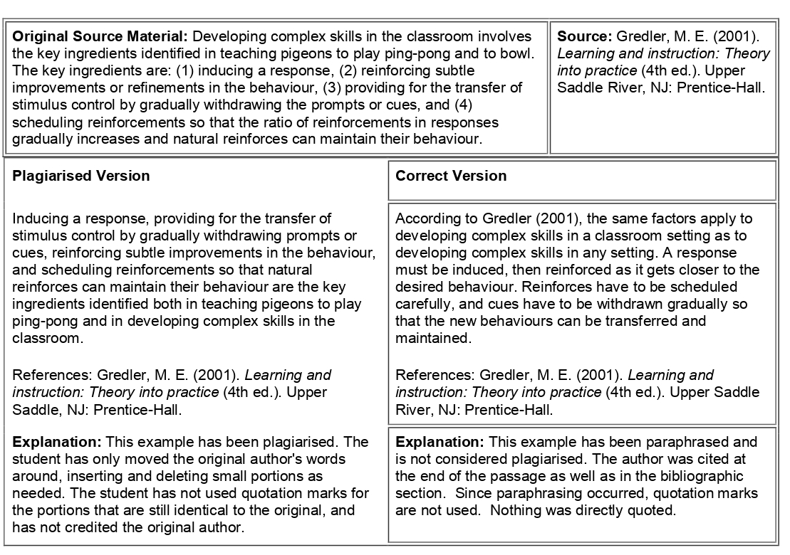
Example 1

Slide 38
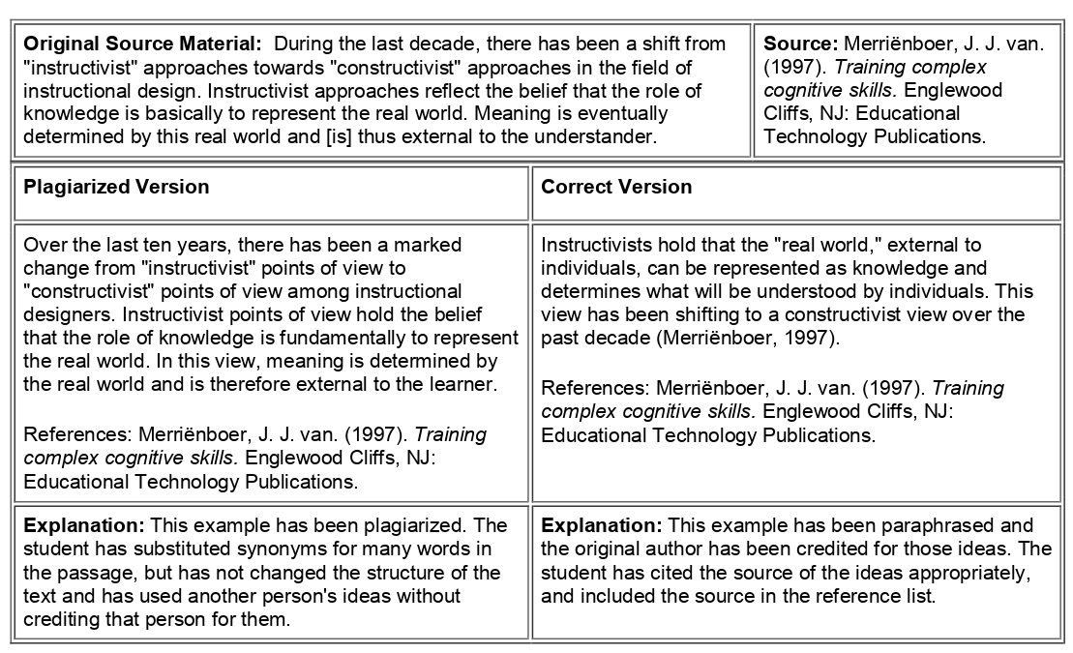
Example 2

Slide 39
Word for Word
A word-for-word example of plagiarism is one in which the writer directly quotes a passage or passages from an author's work without the use of proper quotation marks.

Slide 40
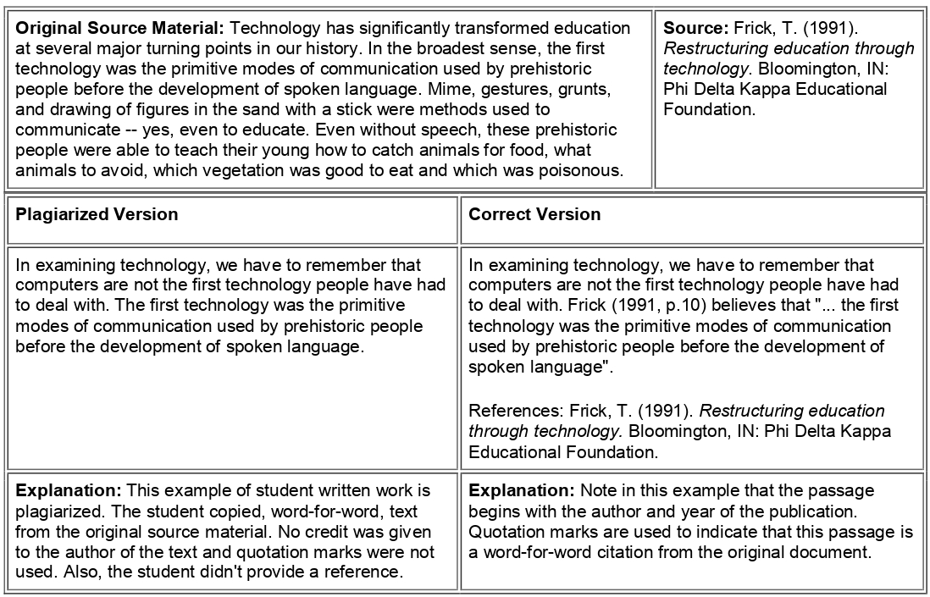
Example

Slide 41
Quoting a Text
You should quote a text when the language of the original text is too distinct or important for you to paraphrase.
When you quote, be sure you copy each word exactly as it was written.
Put quotation marks around the text you are quoting.
Always acknowledge the source.

Slide 42
Direct Quotations
Direct quotations stand apart from your own text.
In general, you directly state your source, quote the text (capitalizing the first word and setting the quotation off with a comma), and cite your source at the end of the sentence (before the final period).

Slide 43
Examples
According to Horowitz et al., “Sufficient energy is available in fluid/acoustic systems to power elements of active flow control systems. Acoustic energy reclamation has been demonstrated using an electromechanical Helmholtz resonator excited by an incident acoustic field, successfully self-powering an electret microphone” [1].
Horowitz et al. claim, “Sufficient energy is available in fluid/acoustic systems to power elements of active flow control systems” [1].
“Sufficient energy is available in fluid/acoustic systems to power elements of active flow control systems. Acoustic energy reclamation has been demonstrated using an electromechanical Helmholtz resonator excited by an incident acoustic field, successfully self-powering an electret microphone,” state Horowitz et al. [1].
“Sufficient energy is available in fluid/acoustic systems to power elements of active flow control systems,” Horowitz et al. report [1].

Slide 44
Block Quotations
Block quotations are used when a direct quotation is longer than three or four lines.
To make a block quotation, introduce the quotation with a complete sentence, followed by a colon.
Skip a line.
Type the quotation single-spaced.
The left side of the whole quotation should be indented (conventionally, this should be about ten spaces or two tabs, although sometimes one tab is acceptable. See the style manual).
Cite your source at the end after the final period.
You do not put quotation marks around a block quotation.

Slide 45
Example
The area of energy reclamation has continued to grow in the last five years. Studies have primarily focused on optical and thermal sources. Recently however, there has been interest in the area of acoustic sources. Horowitz et al. summarize their findings on acoustic energy reclamation:
Sufficient energy is available in fluid/acoustic systems to power elements of active flow control systems. Acoustic energy reclamation has been demonstrated using an electromechanical Helmholtz resonator excited by an incident acoustic field, successfully self-powering an electret microphone. The self- powered microphone calibration shows good agreement with a conventionally powered case. The proof-of-concept demonstration in this paper employed a linear regulator circuit to convert the ac piezoelectric generator voltage into a constant dc voltage. [1]

Slide 46
Indirect Quotations
Indirect quotations are used when you want to integrate a quotation smoothly into the flow of your writing.
Indirect quotations are especially useful when you want to use only a small portion of a text.
You will insert the text right into your sentence, being sure to surround it with quotation marks.
Do not capitalize the first word, as it will be in the middle of your sentence.
As always, state and cite your source.

Slide 47
Example
As Horowitz et al. have demonstrated, it is possible to convert acoustic energy into electrical energy “using an electromechanical Helmholtz resonator excited by an incident acoustic field” [1].
When Horowitz et al. concluded their experiment in powering an electret microphone with reclaimed acoustic energy, they found that the results were equivalent to “a conventionally powered case” [1].

Slide 48
Quotations within Quotations
If you wish to quote a piece of text that already contains a quotation, you use the above rules.
However, the quotation marks existing in the original text are converted to single quotation marks.

Slide 49
Examples
For an example of a direct quotation, the plagiarism worksheet author wrote, “Horowitz et al. claim, ‘Sufficient energy is available in fluid/acoustic systems to power elements of active flow control systems’” [9].

Slide 50
Altering a Quotation
Occasionally, you might need to alter a quotation slightly (in wording only, not content) for clarity or so an indirect quotation reads smoothly.
If you must add or alter a word, put the new word in square brackets.
If you must omit some text (even one word), use an ellipsis.

Slide 51
Example of using square brackets
You are going to quote a sentence in a text that reads, “They invented the point contact transistor.”
To clarify, you would write, “[Shockley, Bardeen, and Brattain] invented the point contact transistor” [3].

Slide 52
Example of using an ellipsis
You could shorten the Horowitz text by writing, “Sufficient energy is available in fluid/acoustic systems to power . . . an electret microphone” [1].

Slide 53
If you wish to begin a direct quotation partway through a sentence of the original text, you will use an ellipsis to indicate you have omitted words and square brackets to capitialize the first word of your quotation.
“According to Horowitz et al., “ . . . [A]n electromechanical Helmholtz resonator excited by an incident acoustic field, successfully self-power[ed] an electret microphone” [1].

Slide 54
Summarize without Plagiarism
To summarize without plagiarizing, thoroughly understand the original text, then rewrite the main ideas and key points in your own words using different sentence structures and vocabulary, while always providing a proper citation.
Avoid copying phrases verbatim, focus on the purpose of the text, and always compare your summary to the original to ensure it is not too similar.

Slide 55
Steps to Summarize without Plagiarism
Understand the Original Text: Read the source material several times to fully grasp its meaning and main arguments.
Identify Key Points: Break the text into sections and note the most important information and arguments.
Rethink and Restructure: Mentally (or on paper) categorize the information and plan how to present it in your own words.
Write in Your Own Words: Close the original text and write the summary using your own vocabulary and sentence structures.

Slide 56
Focus on the Main Idea: Eliminate unnecessary details, repetitive information, and specific examples, and use general terms instead.
Cite Your Source: Even though you're using your own words, the ideas are not yours, so you must cite the original source.
Compare and Refine: Check your summary against the original text to ensure the language isn't too close, and make revisions as needed.

Slide 57
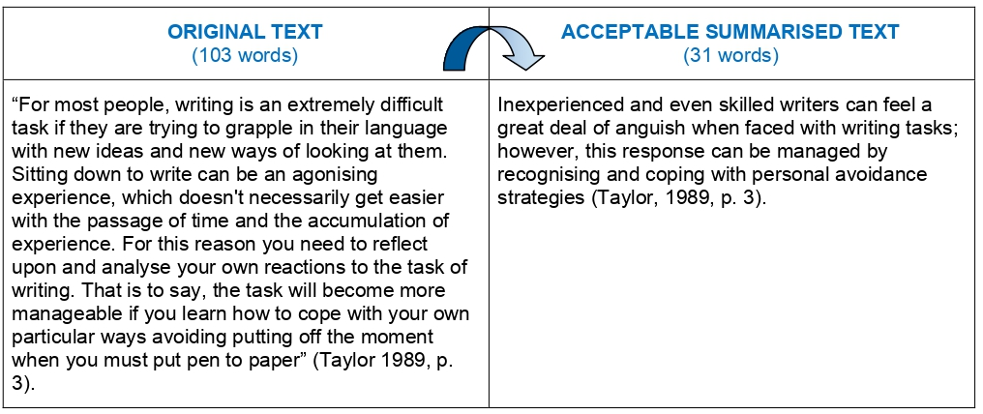
Example

Slide 58
What about Common Knowledge?
You do not have to use quotations or cite sources if you are simply stating common knowledge.
For example, if you mention gravity in a paper, you do not have to cite Newton.
Typically, if a college undergraduate in a general engineering course knows the information, it counts as general knowledge.
Ohm’s law is general knowledge; Maxwell’s equations need to be cited.

Slide 59
Be careful with scientific theories, laws, and formulae.
If you are in doubt whether an idea should be cited, go ahead and cite it.
When writing a formula, you do not put it in quotation marks, but you should introduce and cite the source.

Slide 60

Example of cited formula
The power spectral density of excess noise in semiconductors was observed by Hooge [5] to exhibit an inverse dependence on frequency and is given by the following formula:

Slide 61
Thank You

